Slide 1
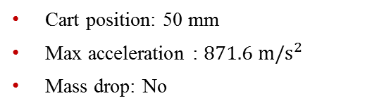
Datasets
High-Rate Overview
Benchmark
Applications
Datasets
Dataset 5 – test 6
Excitations:
Static cart action
Single hammer impact
Electromagnet mass
Cart position: 50 mm
Max acceleration : $871.6 m/s^{2}$
Mass drop: No

Slide 2
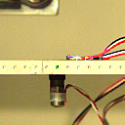
Datasets
High-Rate Overview
Benchmark
Applications
Datasets
Dataset 5 – test 6
Excitations:
Static cart action
Single hammer impact
Electromagnet mass
Cart position: 50 mm
Max acceleration : $871.6 m/s^{2}$
Mass drop: No

Slide 3

Datasets
High-Rate Overview
Benchmark
Applications
Datasets
Dataset 5 – test 7
Excitations:
Static cart action
Single hammer impact
No electromagnet mass
Cart position: 100 mm
Max acceleration : $1866 m/s^{2}$
Mass drop: N/a

Slide 4
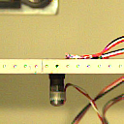
Datasets
High-Rate Overview
Benchmark
Applications
Datasets
Dataset 5 – test 7
Excitations:
Static cart action
Single hammer impact
No electromagnet mass
Cart position: 100 mm
Max acceleration : $1866 m/s^{2}$
Mass drop: N/a

Slide 5

Datasets
High-Rate Overview
Benchmark
Applications
Datasets
Dataset 5 – test 8
Excitations:
Static cart action
Single hammer impact
No electromagnet mass
Cart position: 100 mm
Max acceleration : $1084 m/s^{2}$
Mass drop: N/a

Slide 6

Datasets
High-Rate Overview
Benchmark
Applications
Datasets
Dataset 5 – test 8
Excitations:
Static cart action
Single hammer impact
No electromagnet mass
Cart position: 100 mm
Max acceleration : $1084 m/s^{2}$
Mass drop: N/a

